Slide 1
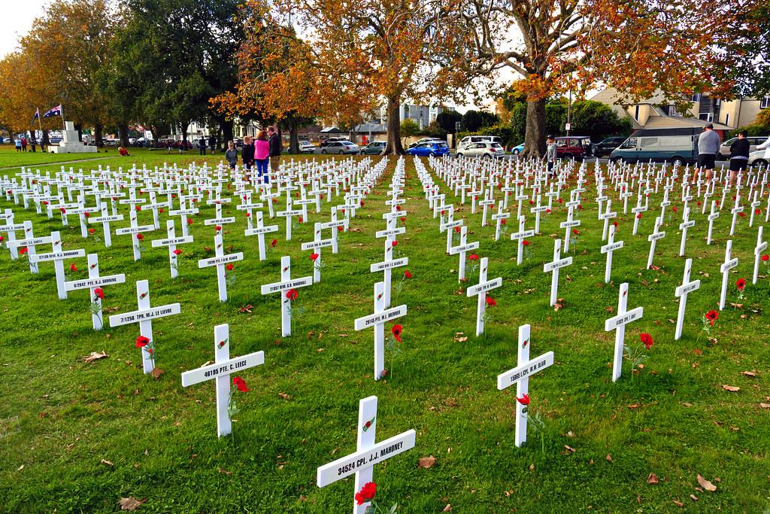
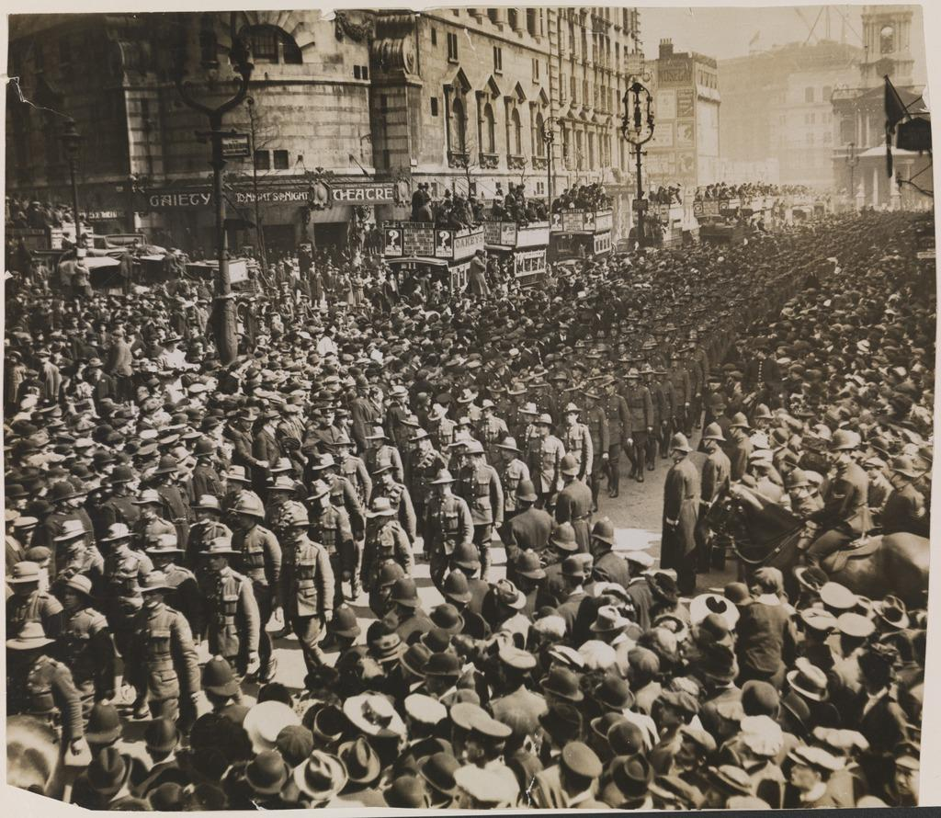
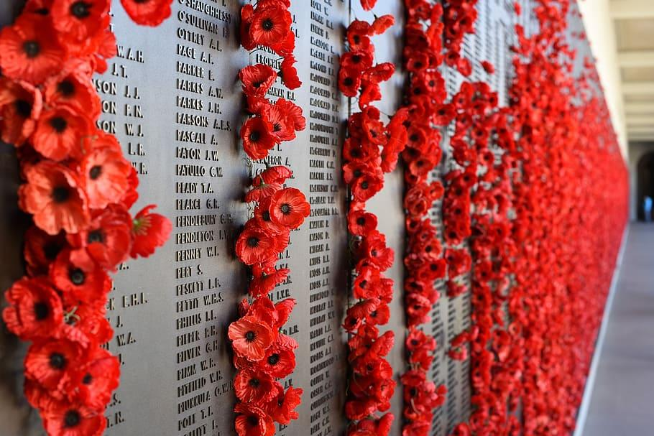
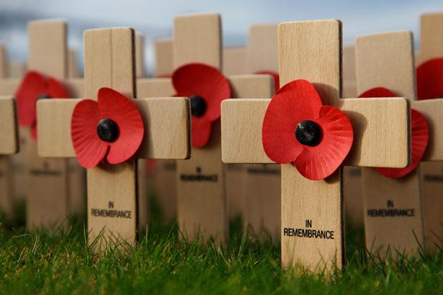
I like anzac day
Because the people
Fighting for there
Lives that's why I like Anzac Day.
Anzac

Slide 2
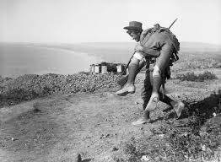
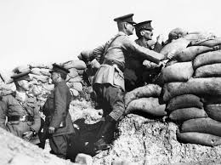
ANZAC Day is like a special day when we remember brave people who helped keep our country safe during wars or serve in peacekeeping operations overseas.

Slide 3
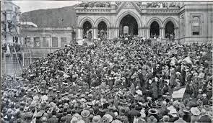
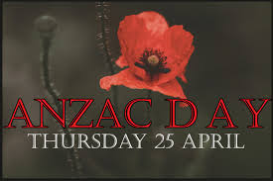
It happens on 25 April every year and is a public holiday in Australia and New Zealand.

Slide 4
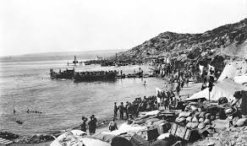
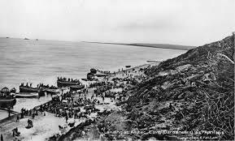
A long time ago, in 1915, some soldiers from New Zealand and Australia (we call them the Anzacs) went to a faraway place called Gallipoli. They wanted to capture a special area called the Dardanelles, which was like a secret door to the Bosphorus and the Black Sea

Slide 5
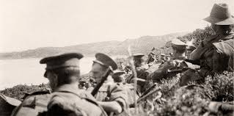
Even though they tried really hard, they didn’t win the battle. But we still remember them because they showed how brave and strong they were

Slide 6
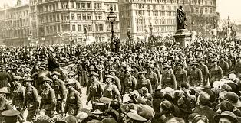
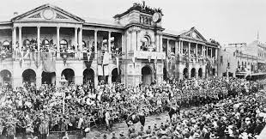
Anzac Day was first observed in 1916

Slide 7
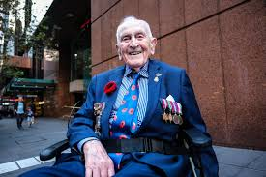
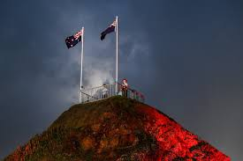
On ANZAC Day, we have ceremonies at special places called war memorials. These ceremonies are like saying “thank you” to the Anzacs. We do things like laying wreaths, playing music, and standing quietly to show respect.

Slide 8
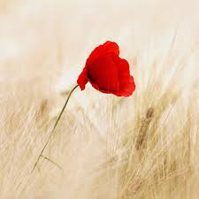
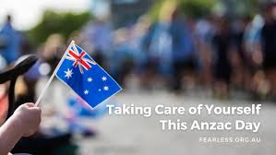
It’s a day to think about how important it is to be kind, brave, and look out for each other. 🌺

